Slide 1
Disability-Inclusive Checklist:
Building Accessible Events
Bailey Rose Boyle
University of Wisconsin - Milwaukee

Slide 2
What does disability look like to you?

Slide 3

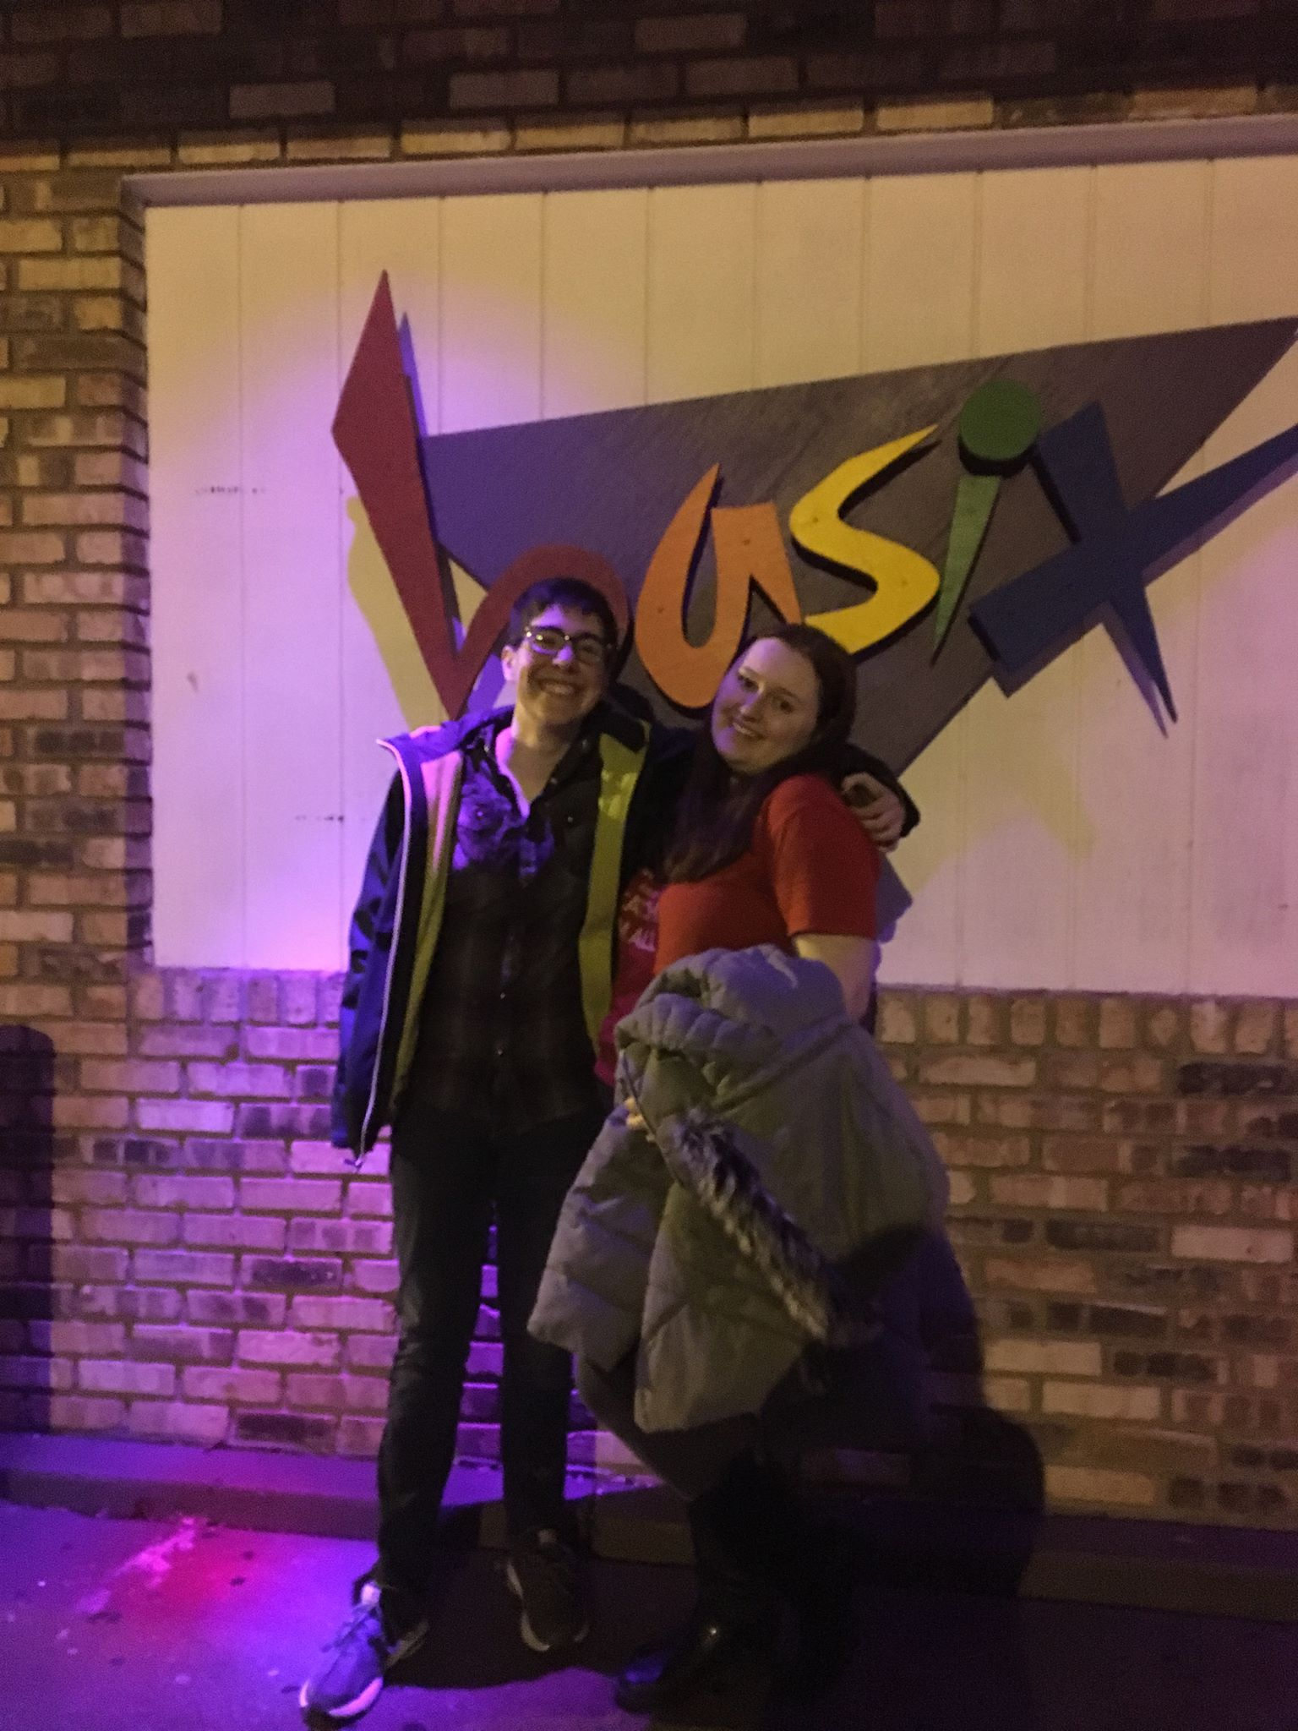
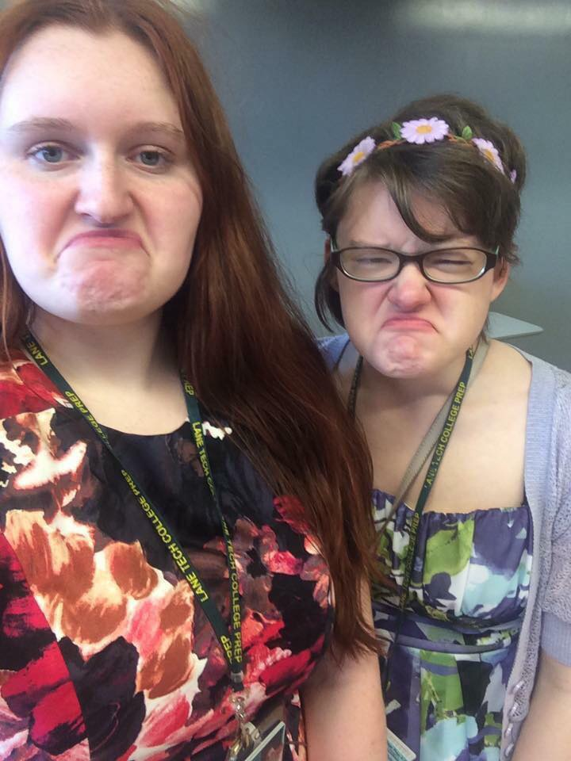
(Some) Faces of Disability

Slide 4
Types of Disabilities
Auditory/Visual
Mobility
Neurological
Psychological
Spectrum of Visibility

Slide 5
Let’s Do an Escape Room!
Reserve a room!
Make the puzzles!
Make a map!
Set it up!
Anything else?

Slide 6
Disability Considerations . . .
Mobility technology
Audio clues
Printed clues
Sensory overload
Distressing themes
Anything else?

Slide 7
It’s YOUR turn!

Slide 8
Tips and Takeaways
Know your laws!
Know your campus!
Pursue feedback!
Advocate for change!
Try group trainings!
Keep trying!

Slide 9
Please fill out the Educational Sessions Feedback form!
Thank you!

